Slide 1
Web Service Toolkit for PHP5
Free and Open Source Software Conference

Slide 2







  Institute at University of Potsdam
    In Germany between Potsdam
    and Berlin
  founded in 1998 by Prof. Dr. Hasso Plattner
  IT Systems Engineering
    Bachelor and Master courses
    Software Engineers
    350 students
http://www.hpi.uni-potsdam.de
Notes:
Gegründet 1998
Stiftung von Prof. Dr. Hasso Plattner
200 Mio € Stiftungsvermögen
Größte private Stiftung Deutschlands im Bildungsbereich
Gelegen am Griebnitzsee zwischen Berlin und Potsdam
Moderner Campus, ideale Studienbedingungen
Momentan ca. 350 Studierende in 6 Jahrgängen

Slide 3
Agenda
Basics on Web Services
Web Service Toolkit for PHP5
  Extended Reflection API and Annotations with PHP
  WSDL-Generator and Adapter-Generator
  SOAP-Handler-Chains and WS-Security for PHP5
  RESTful Web Services
Administration Tool and Policy PlugIn
Live demo of the toolkit
Notes:
Die Gliederung noch überarbeiten
Einzelteile vielleicht unter Web Service Toolkit für PHP5 zusammenfassen

Slide 4
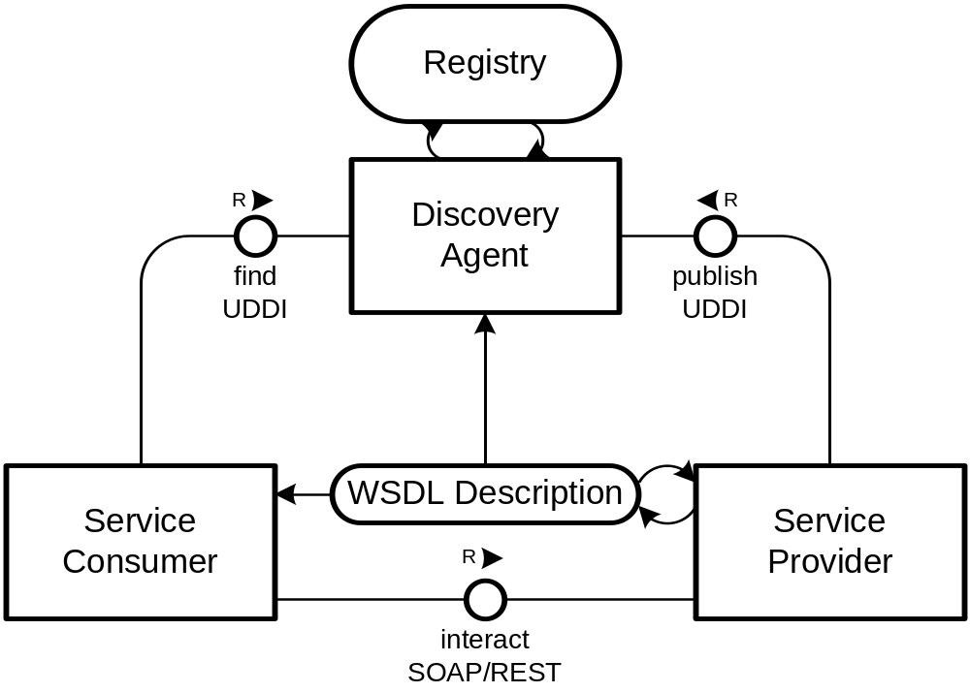
Web Services
  Realizes Functionality
  Used Technologies
    SOAP
    WSDL
    UDDI
    HTTP
    REST
  B2B Integration, connection to client applications,…
Notes:
B2B Integration
Buzzword: SOA
Client Anbindung
Bsp.: EBay, Amazon E-Commerce
Google Suche
Aber auch zur Bereitstellung von z.B. Content, Premium Content an Partner
Hier Einsatzgebiet Lehrveranstaltungen/Vorlesungen/Konferenzvorträge mit z.B. Videoaufzeichnungen
Nutzung durch Partner für Lehrveranstaltungen z.B. in China
Beschreibung über Web Service Description Language

Slide 5
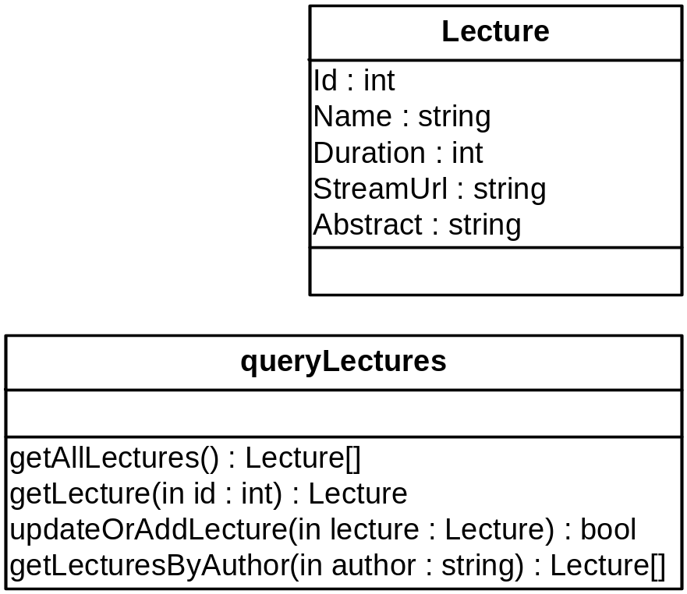
Runing Example
  Example Web Service
    using SOAP Protocol
  Information about Lectures
    Name of a lecture
    Abstract and VideoStream URL
  Content integration on portals
    For reselling
    by premium offers
    To be used by
    business partners
Notes:
Wichtige Punkt für solch einen Web Service
Gesichert durch Authentifizierung
Hier einfaches user/passwort
Je nach scenario vielleciht auch über client-zertifikate usw.
Notwendig einerseits für zugriffskontrolle
Andererseits fürs Abbrechnen der Zugriffe/Billing

Slide 6
Current Situation
Steps for creating web services without tool support
  Create XMLSchema for data types
  Write WSDL service description
  own wrapping for Document/Literal
  Include documentation
  Build SOAP server script
  And you don’t got WS-Security support, so far

Slide 7
Reflection API
  PHP 5.1 Extension
  Usage of PHP build-in Parser
  Structural information at runtime
    Classes
    Methods
    PHP Extensions
  But only very few type information
    PHP is less/dynamic typed language

Slide 8
Annotations
  Additional information in your source code
  Developed from source code comments
    e.g. Pre- and Post-conditions given in comments
    Or conceptual properties
  Support in Microsoft .NET and Java 5 already available
    But not for PHP
  Possible usage scenarios
    Marking or configuring of classes/methods…
    Aspect-Oriented Programming
Notes:
Annotations sind mit der Zeit entstanden
Oft im Quelltext, in den Kommentaren angaben zu verschiedensten Dingen abgelegt
Pre- und PostConditions
Eigenschaften wie ist Webservice, liese sich zwar z.B. mit interfaces oder vererbung ebenfalls realisieren, als markierung
Ist teils jedoch nicht gewünscht, da mit konsequenzen verbunden

Slide 9
PHPDoc as basis for annotations
  PHPDoc widespread, used in many projects for documentation
  Therefore good starting point
  Comparable development in Java with XDoclets
  /**
  * @myAnnotation paramA paramB
  */
  class Lecture {
  /**
  * @return int
  */
  public function getId() { return intval($this->id); }
  /**
  * @param string $value
  */
  public function setName($value) { $this->name = $value; }
  }

Slide 10
Extended Reflection API
  Extending the Reflection API of PHP5.1
    by PHP-Classen/PHP-Code
  Adding Annotation-Mechanism
  Typing of
    Parameters
    Return values
    Attributes
  Types as objects for
  easy usage
    e.g. generate XMLSchema

Slide 11
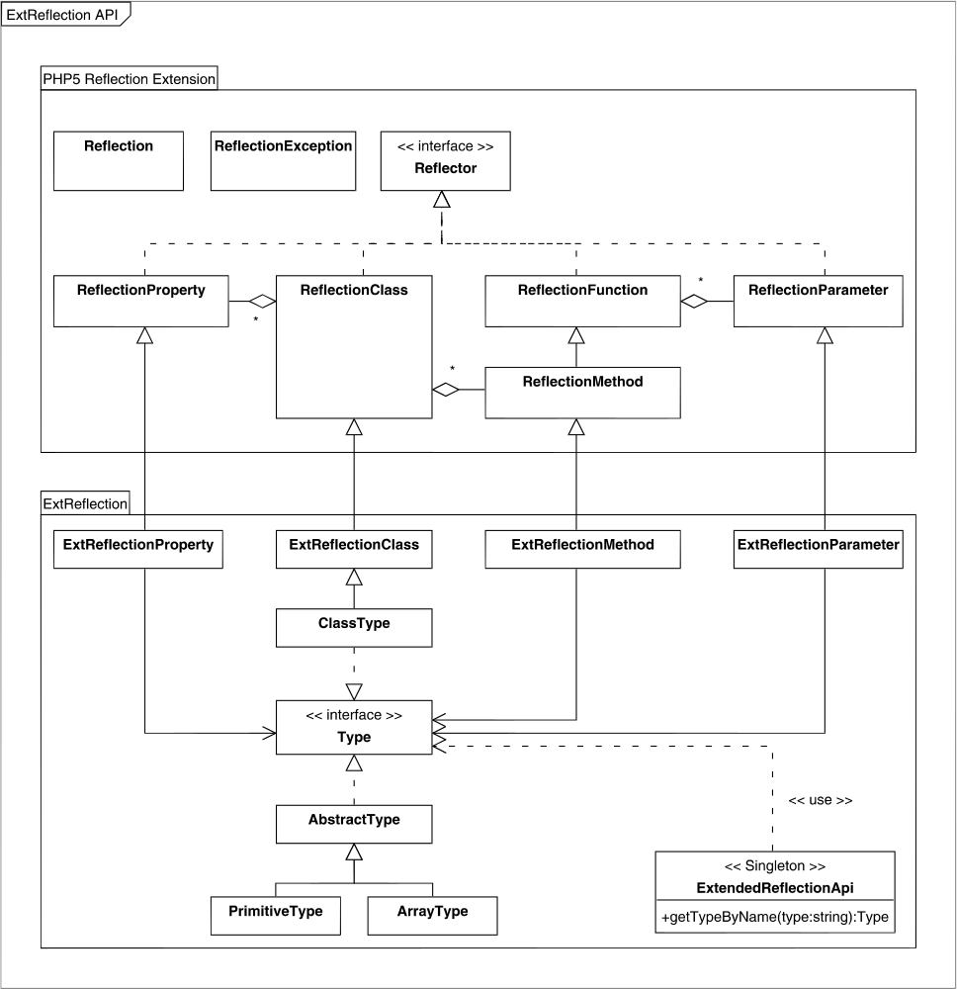
The PHP Extension

Slide 12
Extended Reflection API
  Extended with Annotations and a type system
Notes:
Überleitung
- Aufbauend auf Reflection API

Slide 13
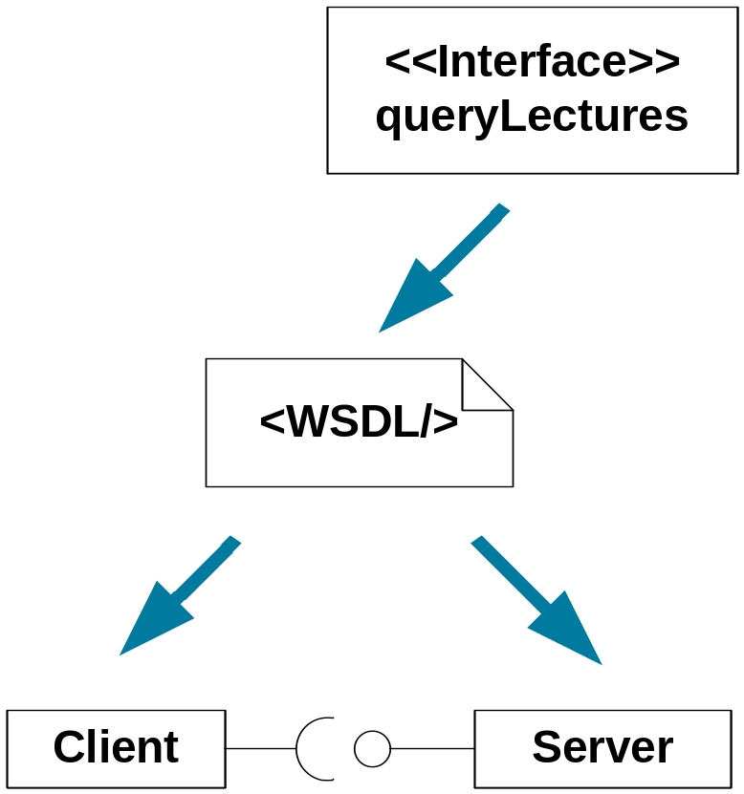
Web Services Description Language
  Platform independent language for describing interfaces
  Description contains
    Interface
    Method signatures
    Data types
  Used with SOAP
  In WSDL 2.0 additional aspects
  for usage with REST

Slide 14
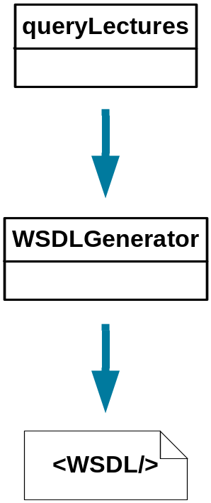
WSDL-Generator
  Generates WSDL from PHP classes or collection of functions
  WSDL 1.1
    conforms to the WS-I Basic Profile by 95%
    Supports RPC Encoded / Literal
    And Document Literal / Wrapped
  Implemented as DOMDocument
  Tested with phpt test cases
    Partially used from SOAP Extension
  Adapter Generator
    for document-wrapped Binding
    Classes for Un/wrapping of arguments and return values
Notes:
Adapterklasse realisiert Kapselung
Unwrapping der Argumente
Wrapping der Rückgabewerte

Slide 15
Agenda
Allgemeines zu Web Services
Web Service Toolkit für PHP5
  Extended Reflection API und Annotations für PHP
  WSDL-Generator und Adapter-Generator
  SOAP-Handler-Chains and WS-Security for PHP5
  RESTful Web Services
Administration Tool and Policy PlugIn
Live demo of the toolkit
Notes:
Die Gliederung noch überarbeiten
Einzelteile vielleicht unter Web Service Toolkit für PHP5 zusammenfassen

Slide 16
further WS-Standards
  Basics are already implemented for PHP
    SOAP: PHP5 Extension, PEAR SOAP, NuSOAP
    UDDI: PEAR-Paket
    WSDL: Generator
  over 20 posibile WS-* Standards for
    Security
    Synchronisation
    Sessioning
  Standards are adding additonal elements to the SOAP header

Slide 17
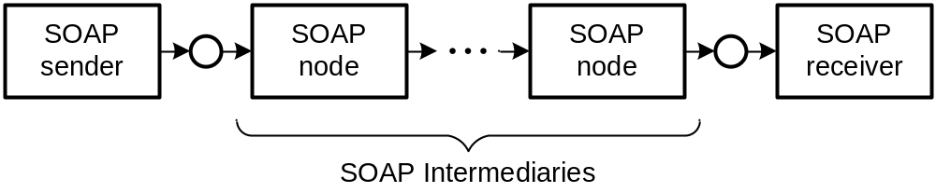
SOAP-Intermediaries
  SOAP-Standard describes intermediaries
  Intermediaries are working on SOAP message before reaching Ultimate Receiver
  additional features indipendent from final Web Service
  Implementation pattern: Handler-Chain

Slide 18
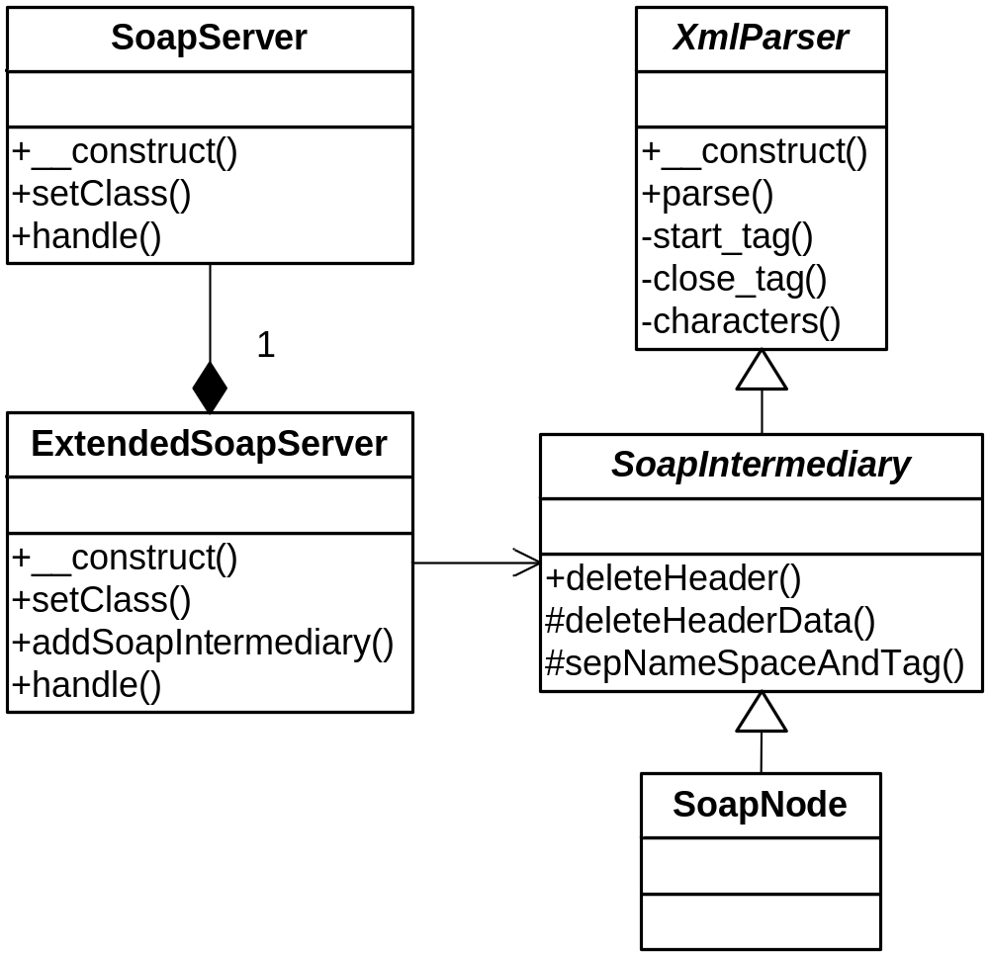
Handler-Chain-Mechanism for PHP5

Slide 19
WS-Security for PHP5
  Security concepts for Web Services:
    confidentiality => SSL (SOAP via HTTPS)
    authentication => WS-Security + Token Profiles
    authorization => Application
  Security components currently left: WS-Security
  WS-Security defines SOAP-Header-Element for security related data
  Different profiles specifies several authentication mechanisms
  First profile to be used with PHP: Username Token Profile 1.0

Slide 20
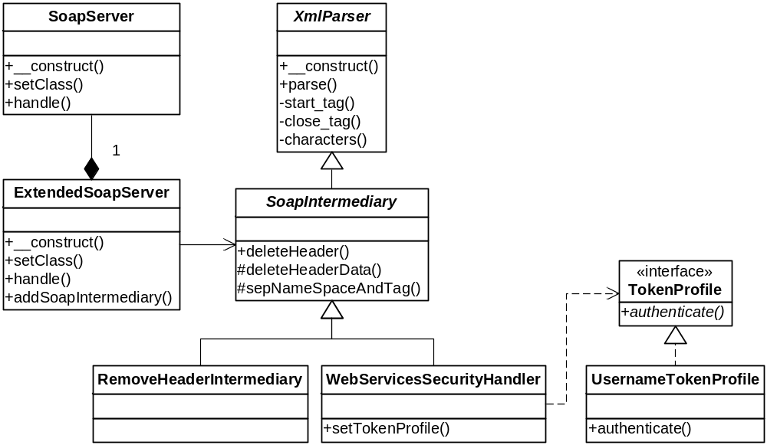
Username Token Profile 1.0 (Server)

Slide 21
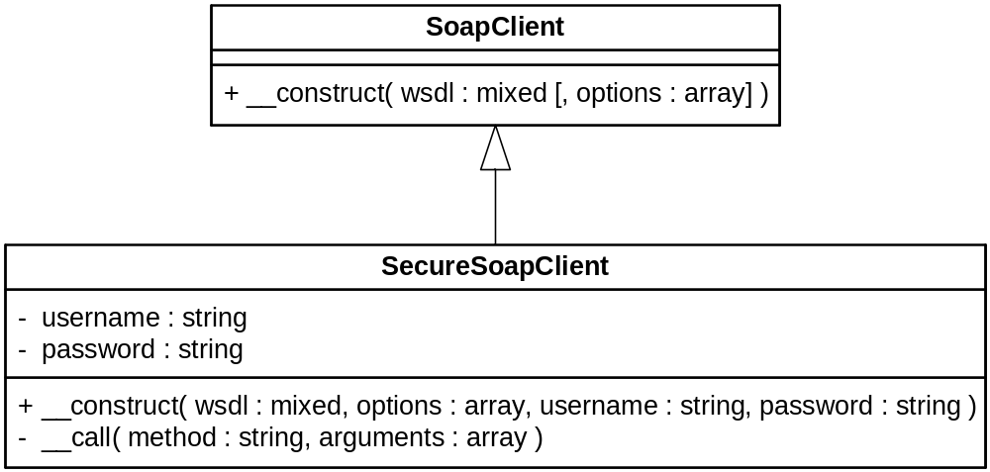
Username Token Profile 1.0 (Client)

Slide 22
Representational State Transfer
  Alternative to SOAP Web Services
  Resource oriented approach
  HTTP-REST
    Just use HTTP Methods
      GET, POST, PUT, DELETE
    Payload semantic of messages instead of RPC semantic
  Implemented with a RemoteFacade
    Mapping from URIs to PHP methods
    Custom De/Serializer for create PHP objects
    REST-Server configuration generated from code annotations
  Security by TLS or DigestAuth (RFC2617)
Notes:
Roy Thomas Fielding
uniforme und minimale Interfaces
Bei SOAP definiert jede Anwendung/Web Service eingenes Interface
Vorteile Interoperabilität
Aussagen über allgemeines Verhalten der Dienste möglich, da uniforme Schnittstelle → uniforme Semantik
Verwendung des allgemeinen HTTP-URI Namensraumes für alle Resourcen

Slide 23
Administration Tool & Policy Plug-In
  Administration Tool
    automated creation of Web Services from existing applications
    Classes used as web services identified by annotations
    Administration via a Web-Frontend
      select classes and methods
      generates SOAP- and REST-Server scripts
      generates WSDL file and Adapter-Classes
      SOAP-Server optional with WS-Security
  Policy Plug-In for WSDL-Generator
    filters methods, to be hidden from web services
    Adds comments to WSDL Ports from source code documentation
    Enables admin to edit published comments

Slide 24
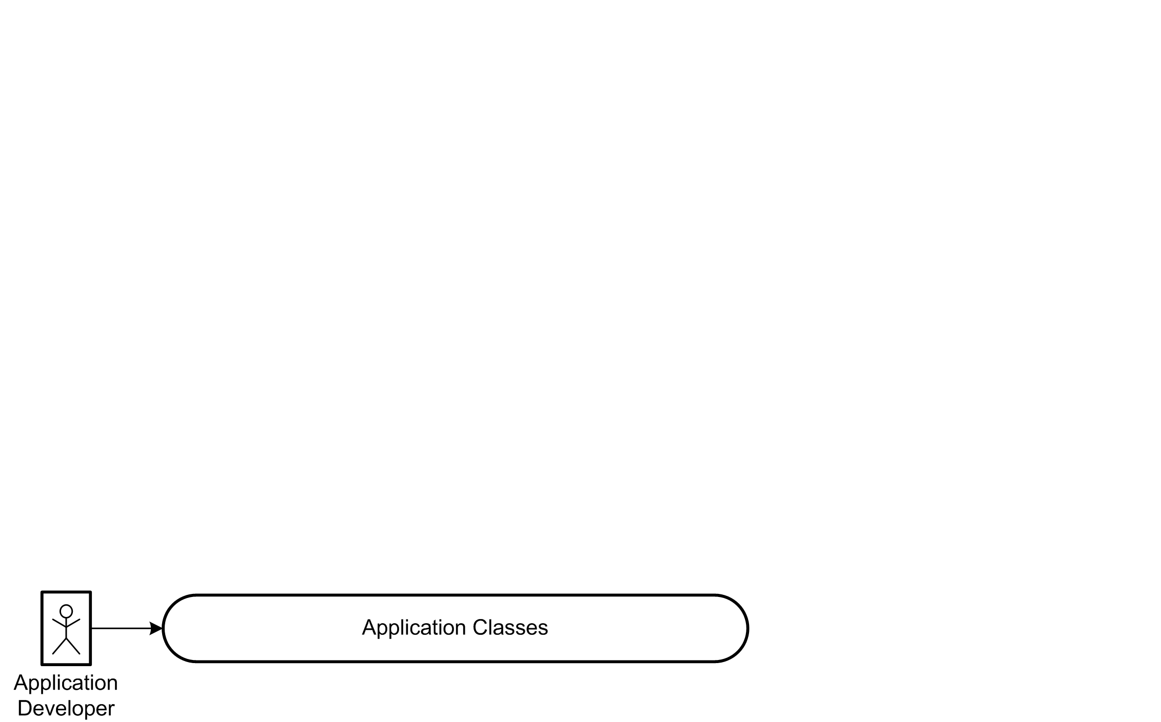
Tool Overview

Slide 25
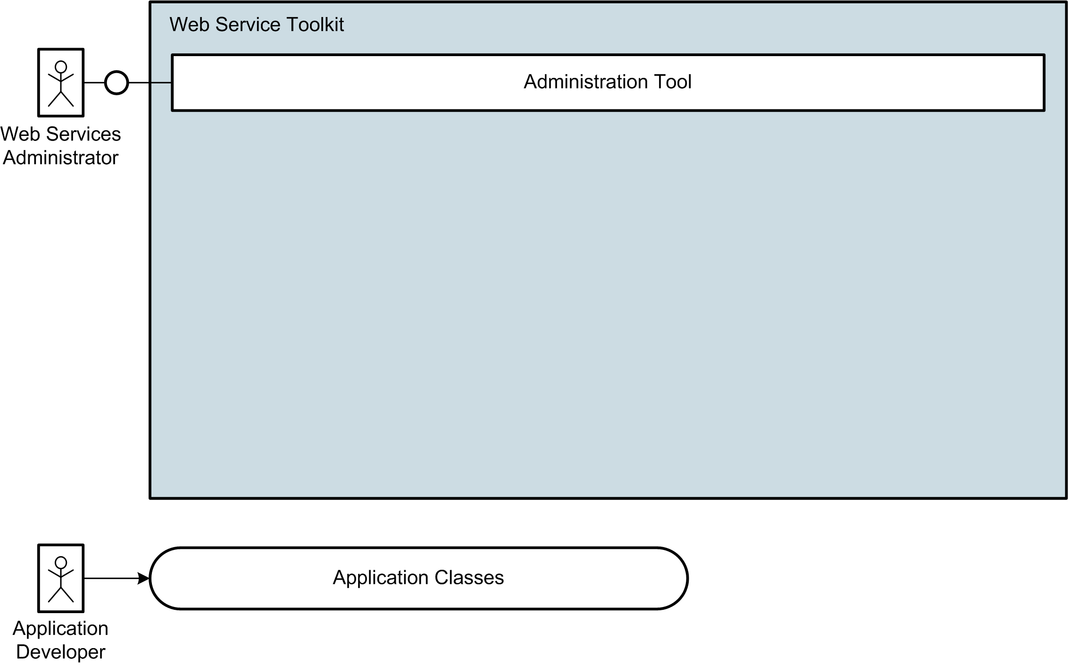
Tool Overview

Slide 26
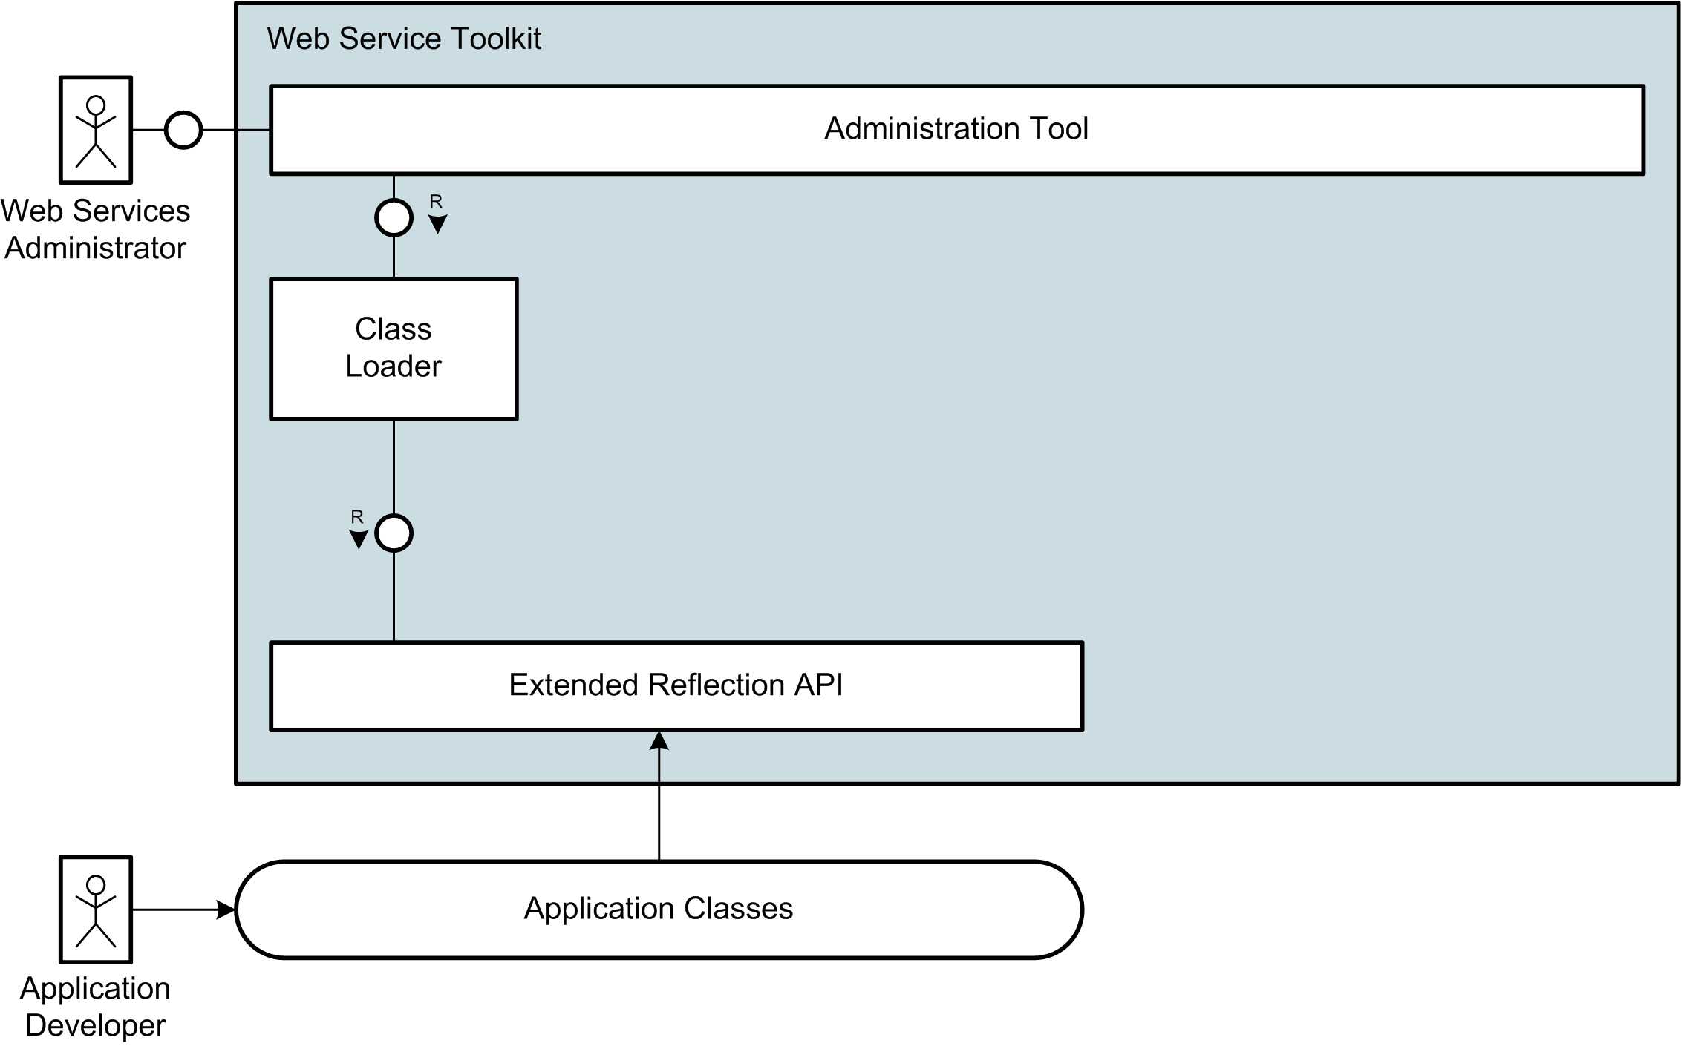
Tool Overview

Slide 27
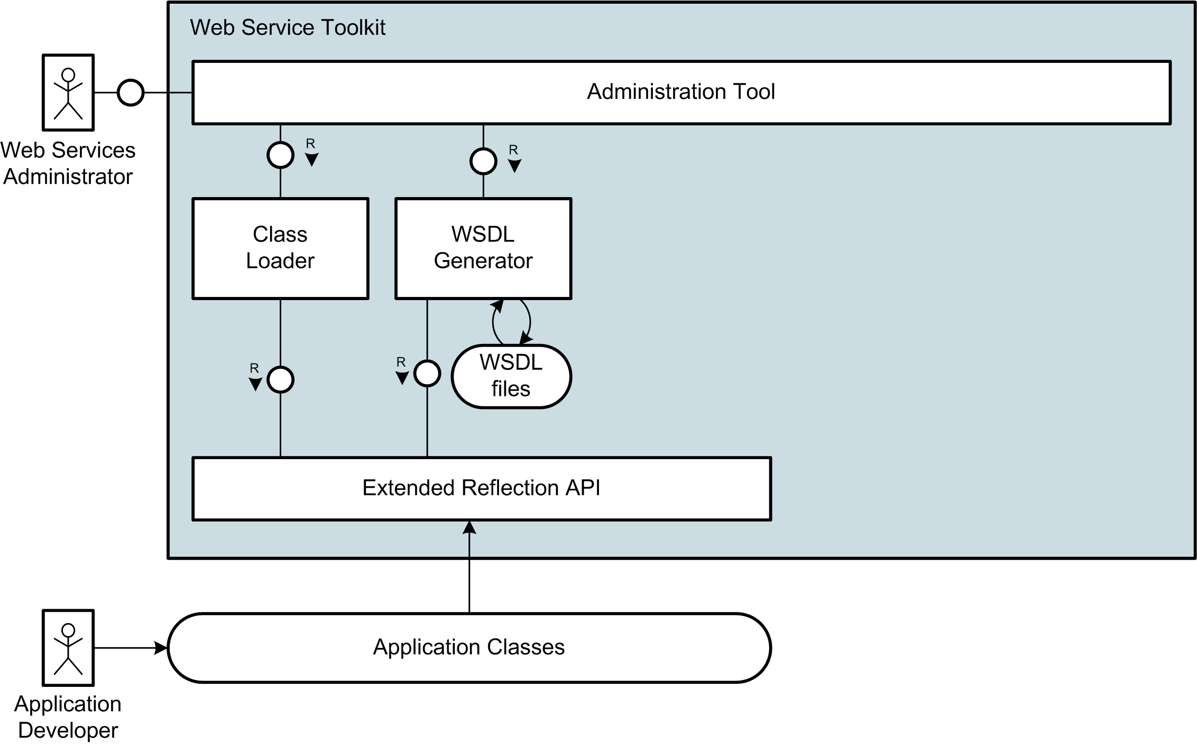
Tool Overview

Slide 28
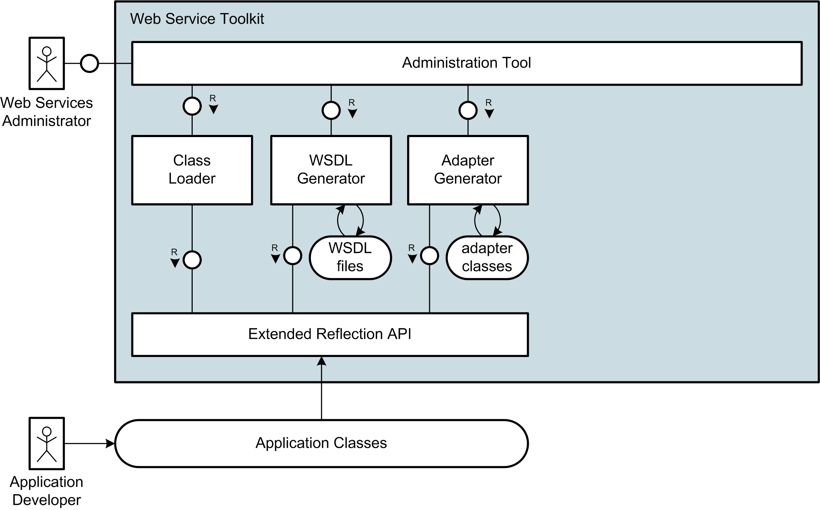
Tool Overview

Slide 29
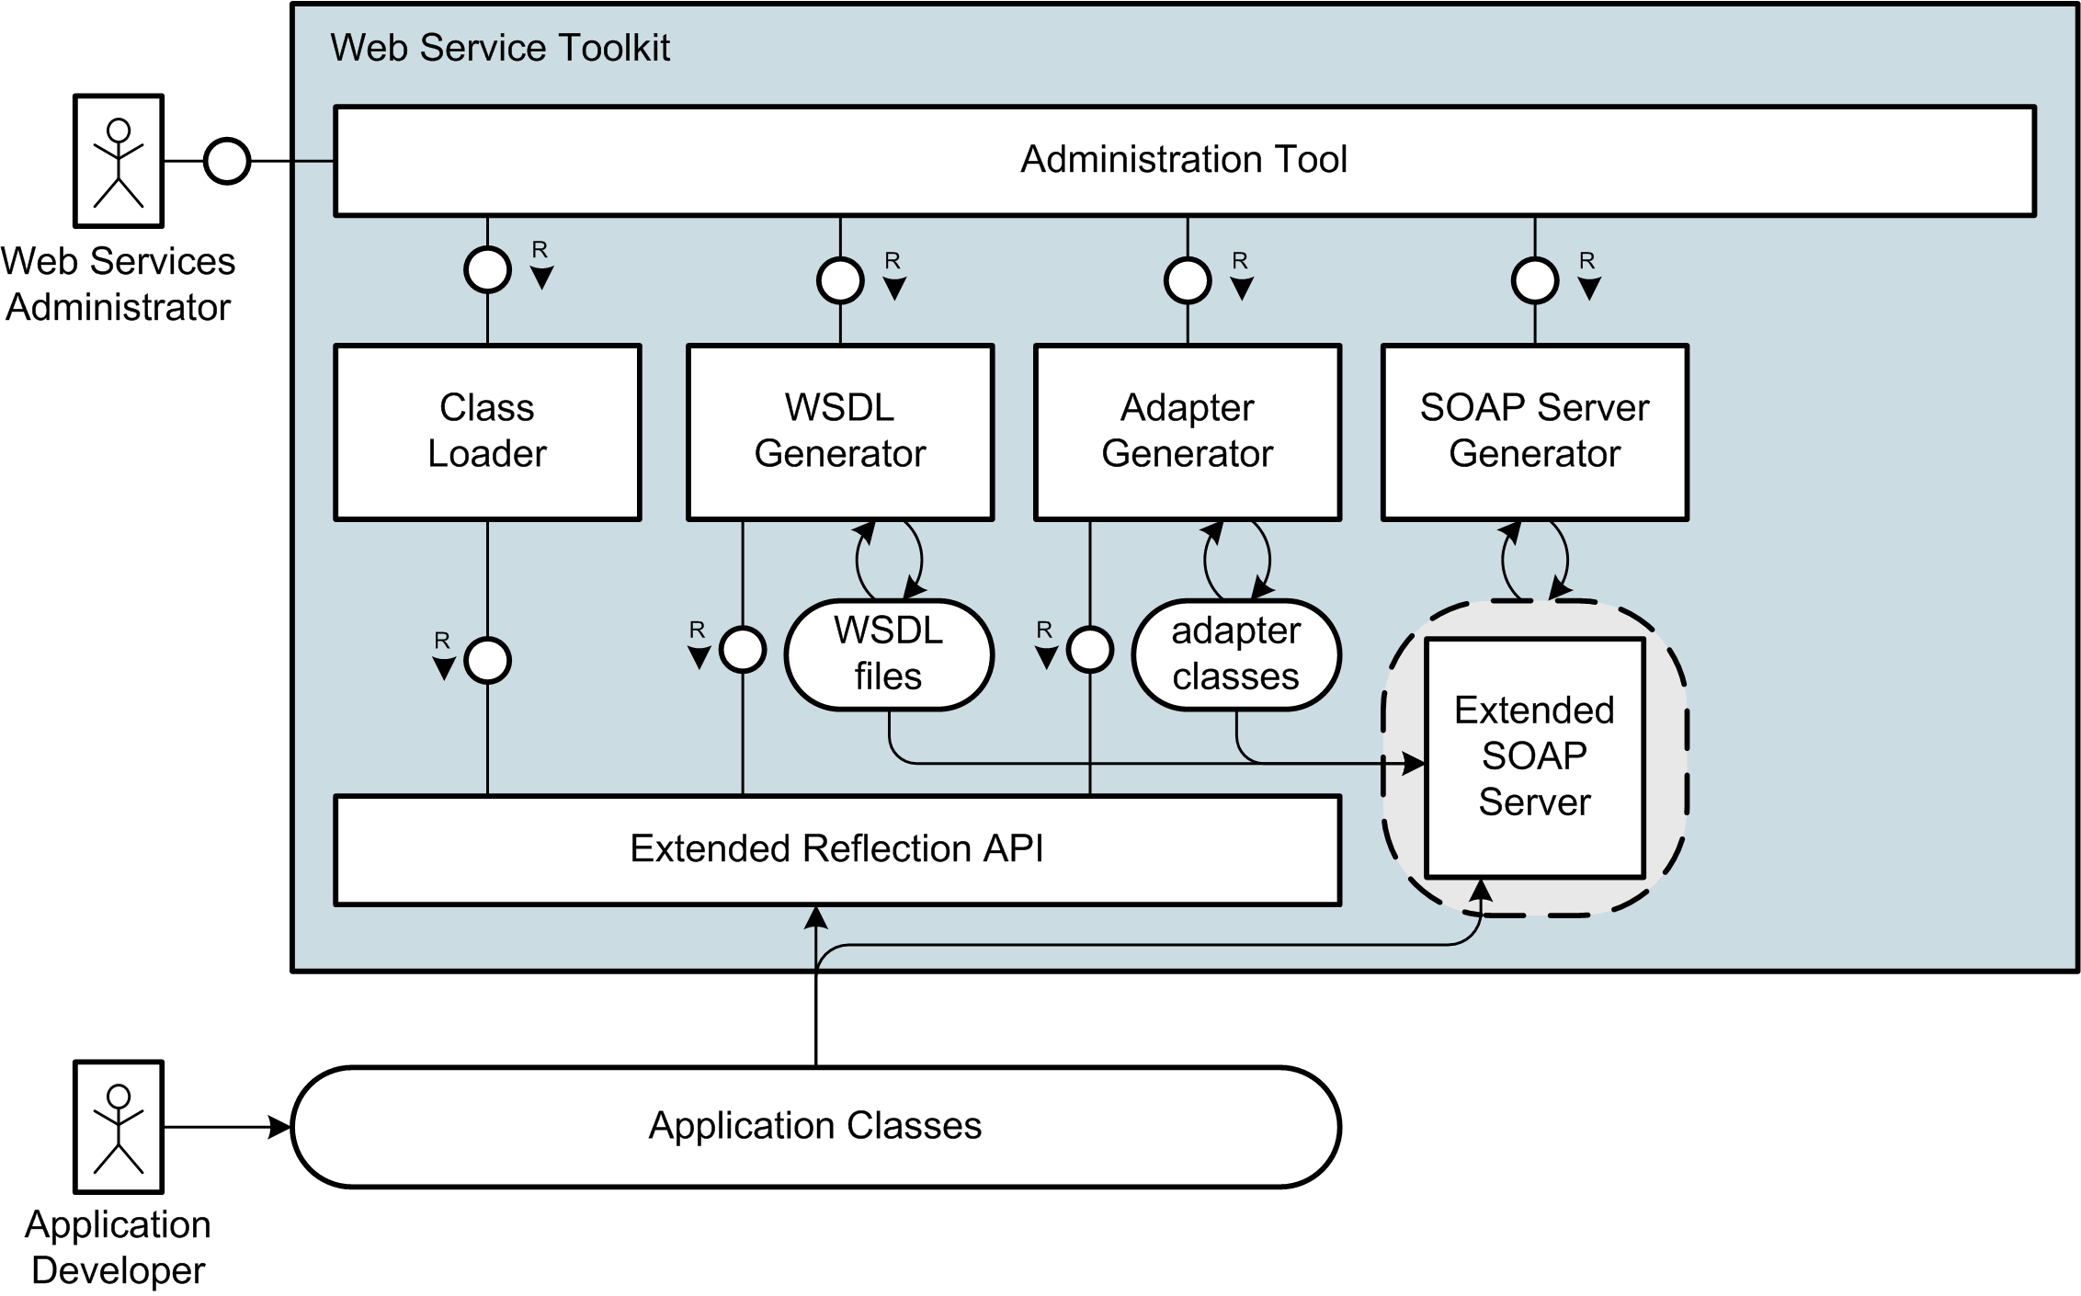
Tool Overview

Slide 30
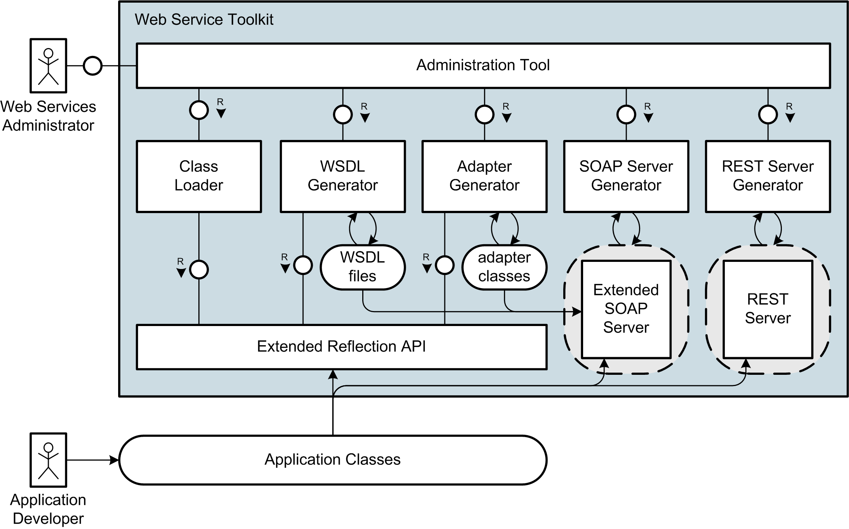
Tool Overview

Slide 31
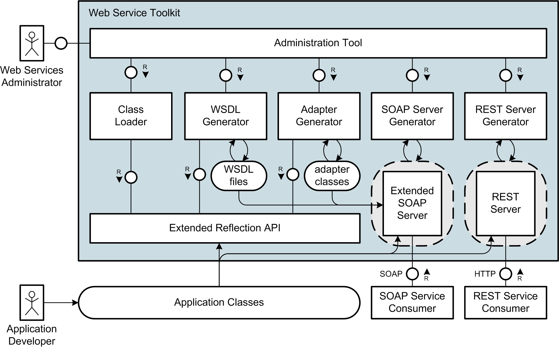
Tool Overview

Slide 32
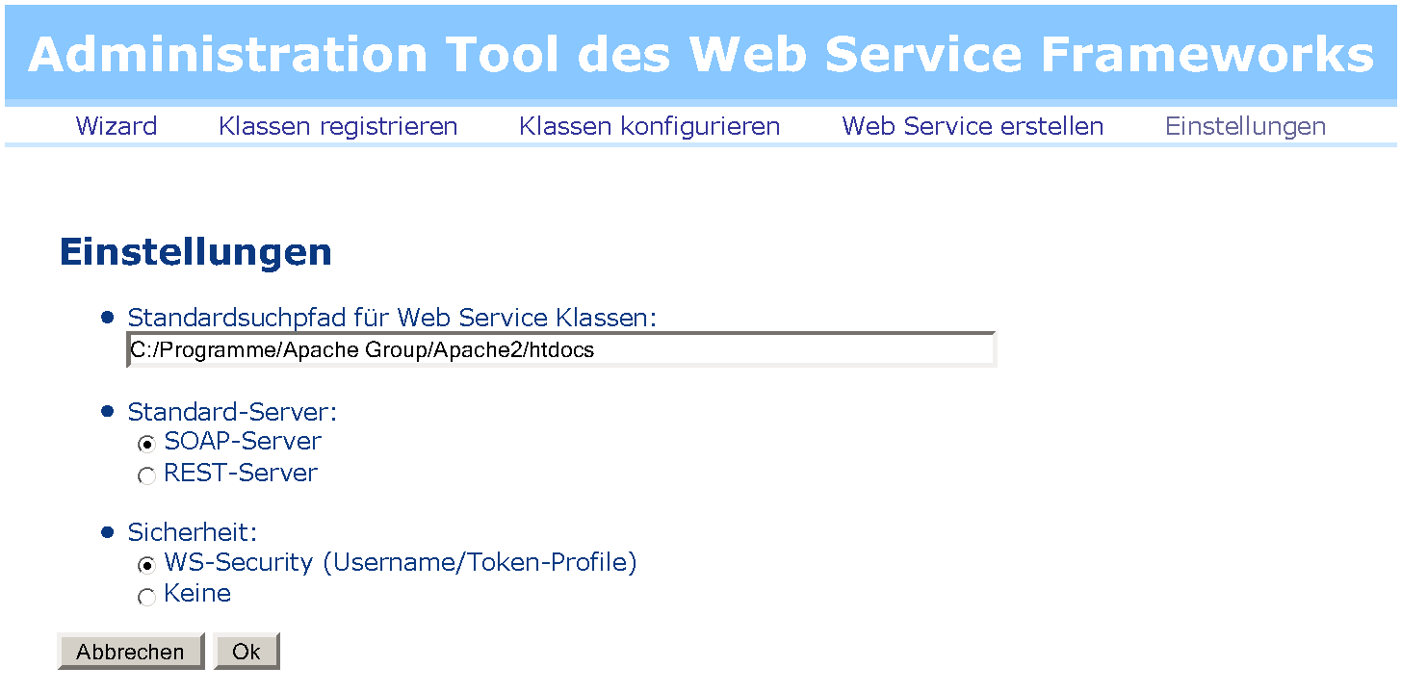
Livedemo des Toolkits

Slide 33
In brief
  Extended Reflection API with type information
  PHP with Annotations
  WS-I conform WSDL-Generator
  document/literal-Adapter-Generator
  Handler-Chain-Mechanism for SOAP processing
  implementation of WS-Security and Username Token Profile
  RESTful Web Services
  Administration Tool for comfortable creation und management of SOAP- und REST-Services
Notes:
Die Gliederung noch überarbeiten
Einzelteile vielleicht unter Web Service Toolkit für PHP5 zusammenfassen

Slide 34
Web Service Toolkit for PHP5
Additional Information and Toolkits download at: http://toolslave.com/froscon.html

Slide 35
Web Service Toolkit for PHP5

Slide 36
The Core Web Services Protocol Stack
Discovery | UDDI (Itself a Web Service)
Description | WSDL, WSFL/XLANG, others to come
Access | SOAP, SOAP with attachments, XML-RPC, REST
Transfer | HTTP, SMTP, FTP, others
Transport | TCP/IP, UDP, others

Slide 37
Web Services Description Language (WSDL)
A WSDL document uses the following elements:
  Types– a container for data type definitions using some type system (such as XSD).
  Message– an abstract, typed definition of the data being communicated.
  Operation– an abstract description of an action supported by the service.
  Port Type– an abstract set of operations supported by one or more endpoints.
  Binding– a concrete protocol and data format specification for a particular port type.
  Port– a single endpoint defined as a combination of a binding and a network address.
  Service– a collection of related endpoints
Source: W3C.org

Slide 38
Adapter-Generator
/**
* @param int $id
* @return Lecture
*/
public function getLecture($id) {…}
public function getLecture($param) {
return array("Lecture“
=> $this->target->getLecture($param->id));
}

Slide 39
WS-Security
Username Token Profile 1.0
<wsse:Security>
<wsse:UsernameToken>
<wsse:Username>Stefan</wsse:Username>
<wsse:Password Type="...#PasswordDigest">
weYI3nXd8LjMNVksCKFV8t3rgHh3Rw==
</wsse:Password>
<wsse:Nonce>WScqanjCEAC4mQoBE07sAQ==</wsse:Nonce>
<wsu:Created>2006-06-24T11:00:00Z</wsu:Created>
</wsse:UsernameToken>
</wsse:Security>

Slide 40
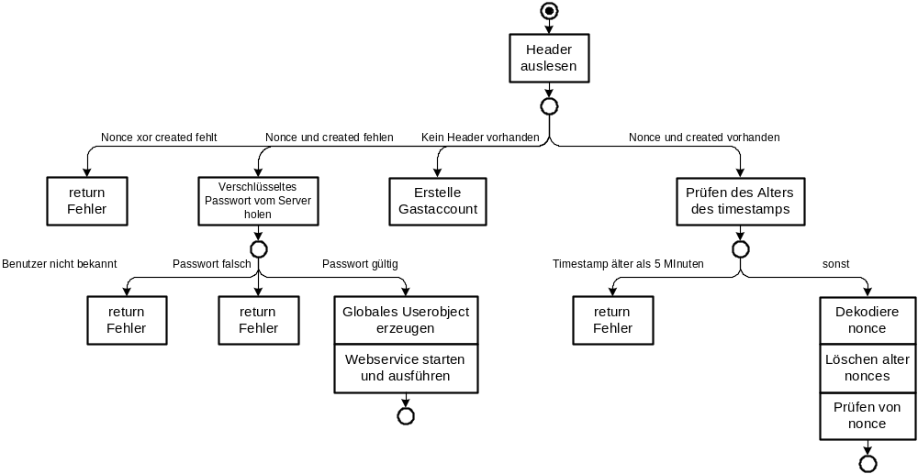
Username Token Profile 1.0
Ablauf (1/2)

Slide 41
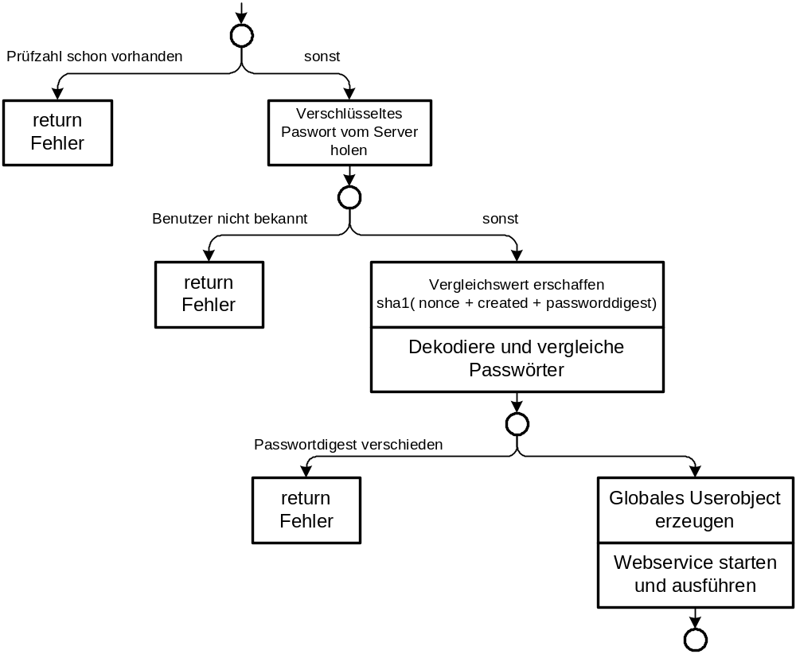
Username Token Profile 1.0
Ablauf (2/2)

Slide 42
Quellen und Literaturverweise
White Papers
[1] Einführung in XML Web Services, Oktober 2005
[2] Web Services Facade for PHP5 – Konzeption, Januar 2006
[3] Web Service Toolkit für PHP5, März 2006
zum Download unter http://toolslave.com/froscon.html
Weitere Quellen
[4] RESTful Web Services, Januar 2006
http://www.stefan-marr.de/artikel/restful-web-services.html
[5] SOAP Version 1.2 specification, W3C Recommendation World Wide Web Consortium (W3C), Juni 2003. http://www.w3.org/TR/soap/
[6] Web Services Description Language (WSDL) 1.1, W3C Note World Wide Web Consortium (W3C), März 2001. http://www.w3.org/TR/wsdl/
[7] Username Token Profile 1.0, OASIS, Januar 2004
http://docs.oasis-open.org/wss/2004/01/oasis-200401-wss-username-token-profile-1.0.pdf

